Slide 1

EE-371 : Control Systems
Lecture#33
Root Locus for Variations of Parameters other than K
Root Locus for Positive-Feedback
Systems
Pole Sensitivity
Textbook: Chapter # 08 (5th edition)
Text Book: Control Systems Engineering by Norman S. Nise 5th Edition
Instructor: Ms Neelma Naz
Class: BEE 12 C/D
School of Electrical Engineering and Computer Science
Department of Electrical Engineering

Slide 2
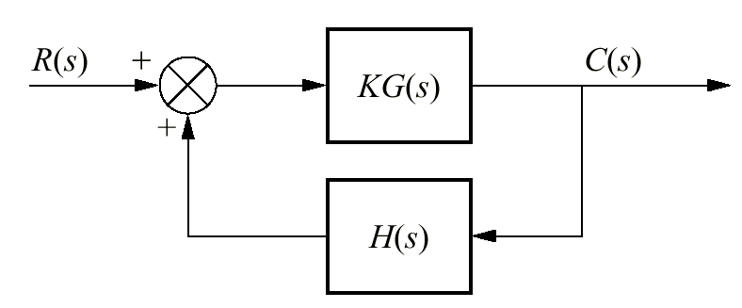

Definition
The closed-loop poles of the feedback control system:
-
are the roots of the characteristic equations:
The root locus is the path of the poles traced out in the s-plane as a system parameter varies from zero to infinity

Slide 3
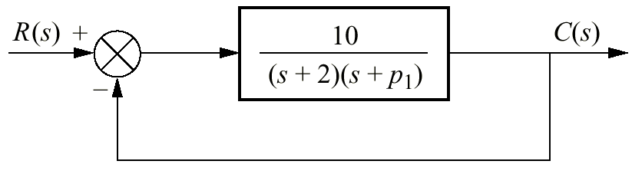
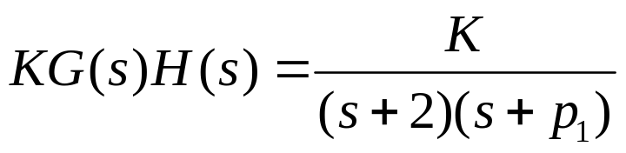
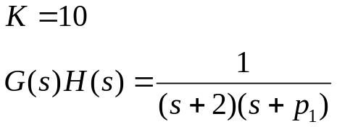
Root Locus for Variations of Parameters other than K
How can we obtain the root locus for variation of p₁
????

Slide 4
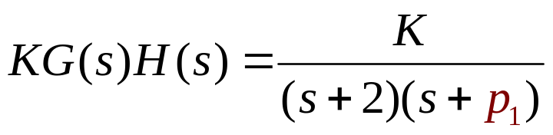
Problem
Parameter p₁ is not a multiplying factor of the function
Solution
Create an equivalent system where p₁ appears as the forward-path gain

Slide 5
The denominator of closed-loop transfer function's is:
1 + KG(s)H(s)
-
We want to create an equivalent system whose denominator is:
1 + p₁G(s)H(s)

Slide 6
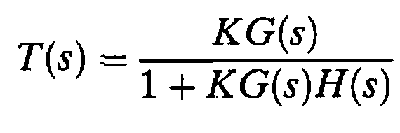
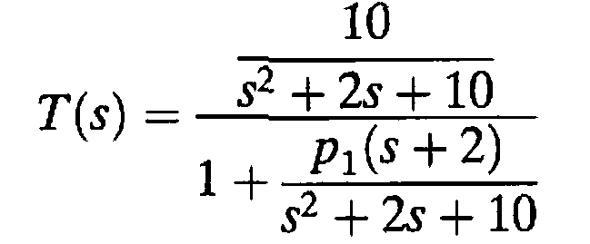
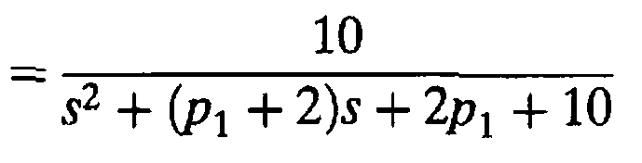
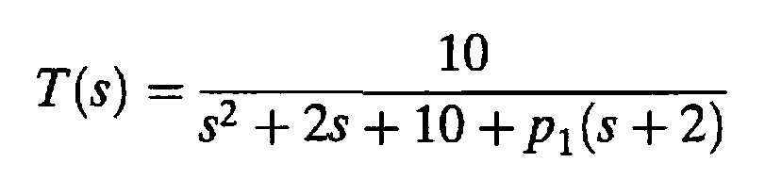
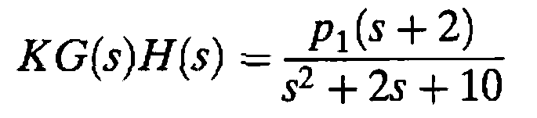

Slide 7
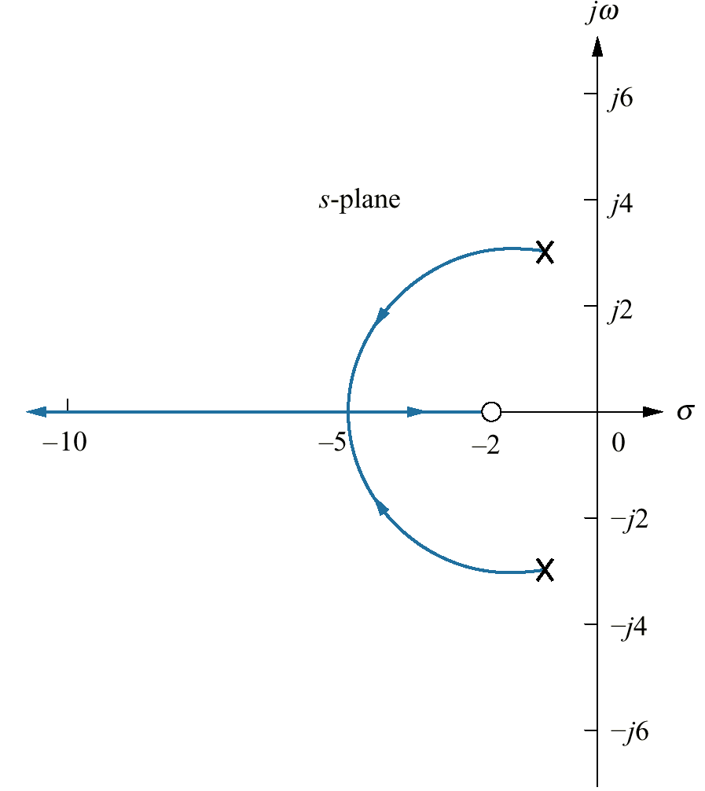
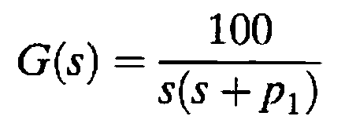
Assignment
Exercise 8.7
PROBLEM: Sketch the root locus for variations in the value of p₁ for a unity feedback system that has the following forward transfer function:

Slide 8
Root Locus for Positive-Feedback
Systems

Slide 9
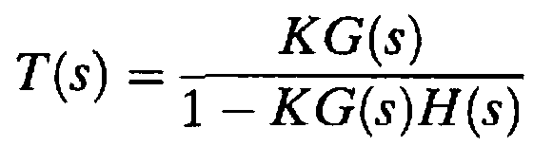


A positive-feedback system can be thought of as a negative-feedback system with a negative value of H(s)
The transfer function for the positive-feedback System is:

Slide 10
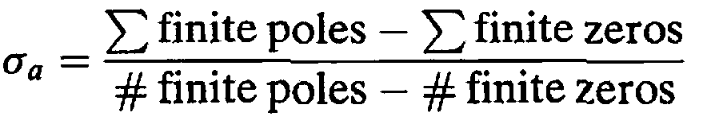
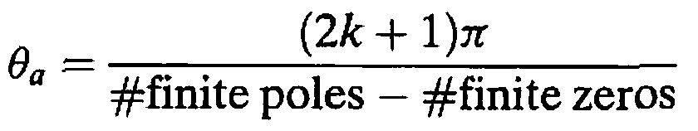
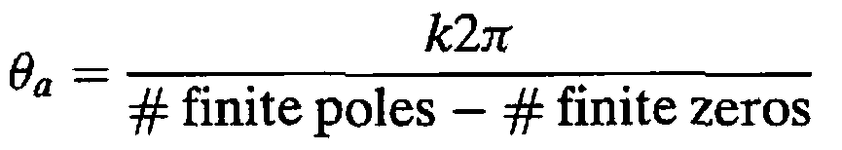
Real-axis segments:
On the real axis, the root locus for positive-feedback systems exists to the left of an even number of finite open-loop poles and/or finite open-loop zeros.
the real-axis intercept
For negative feedback system
Angle with the real axis

Slide 11
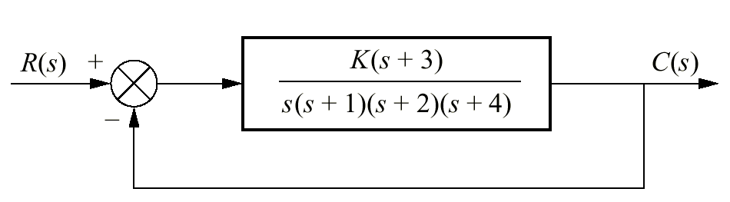
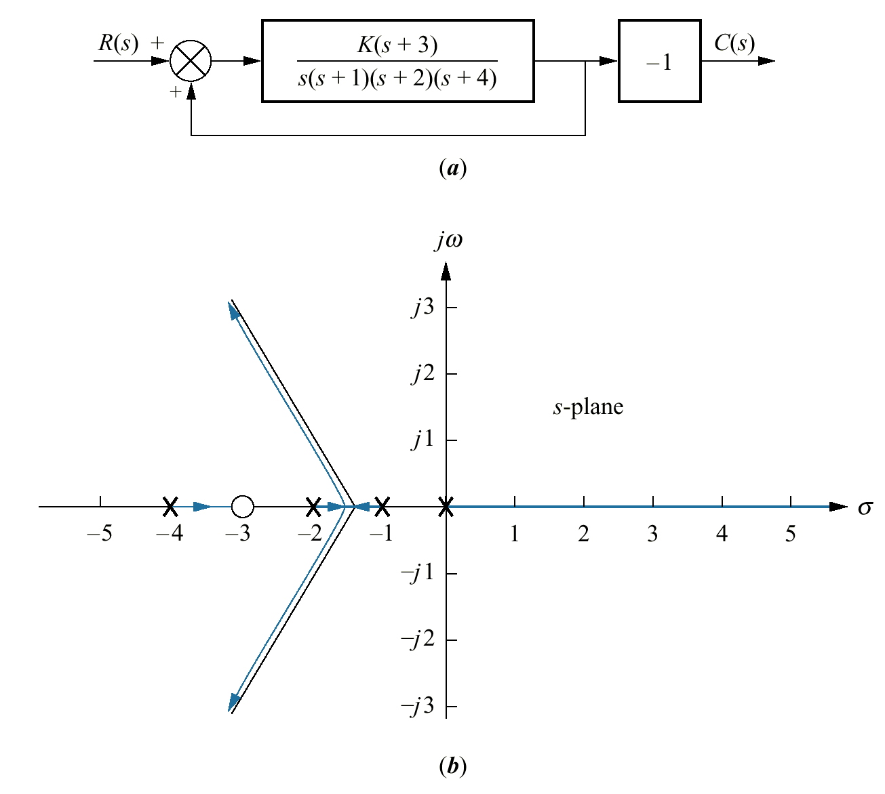
Example 8.9
Root Locus for a Positive-Feedback System
PROBLEM: Sketch the root locus as a function of negative gain, K, for the system shown in the Figure.
_
SOLUTION: The equivalent positive-feedback system found by pushing -1, associated with K, to the right past the pickoff point is:

Slide 12
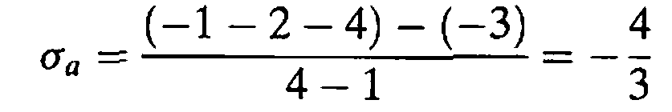
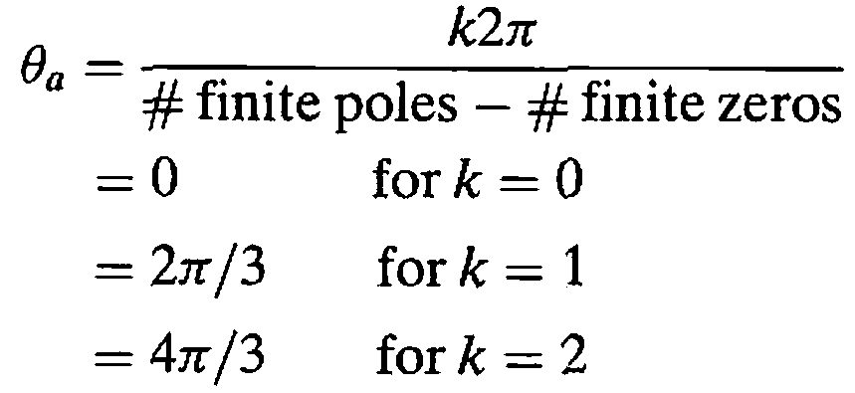

Slide 13
Pole Sensitivity

Slide 14
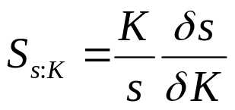
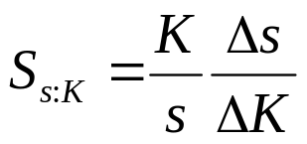
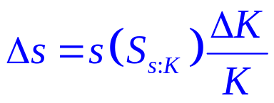
Definition
Root sensitivity is defined as the ratio of the fractional change in a closed-loop pole to the fractional change in a system parameter.
Converting the partials to finite increments, the actual change in the closed-loop poles is approximated as:
The sensitivity of a closed-loop pole, s, to gain, K is:
where s is the current pole location, and K is the current gain

Slide 15
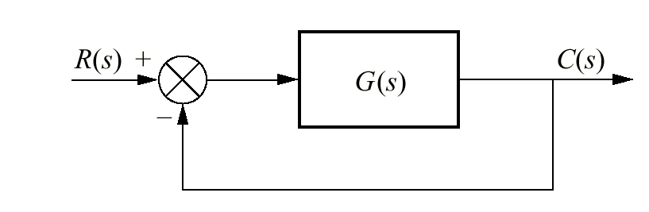
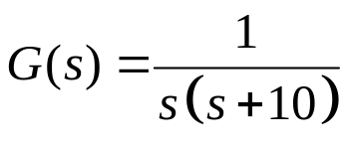
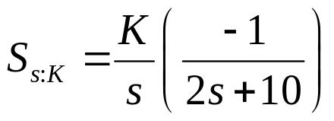
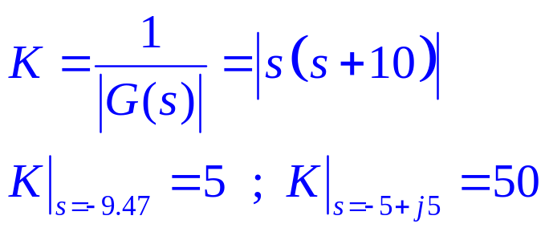
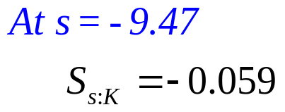
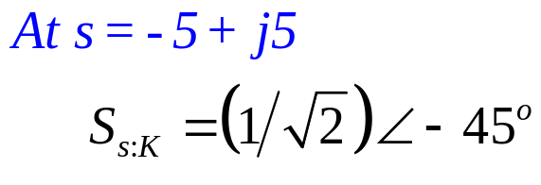
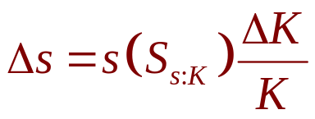
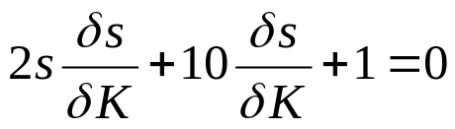
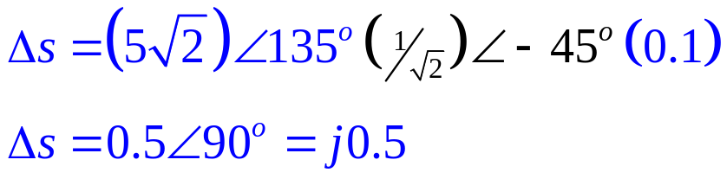
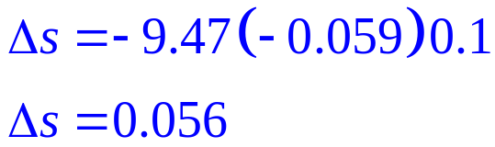
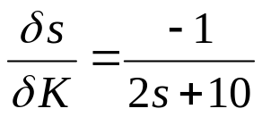
Root Sensitivity of a Closed-Loop System to Gain Variations
Example 8.10
PROBLEM: Find the root sensitivity of the system shown in the Figure at s = -9.47 and s = - 5 + j5. Also calculate the change in the pole location for a 10% change in K.
K
SOLUTION:
The characteristic equation is:
s² + 10s + K = 0
Differentiating with respect to K

Slide 16
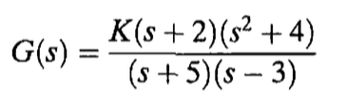
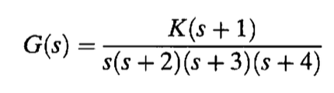
Root Locus - Examples

Slide 17

???

